Slide 1
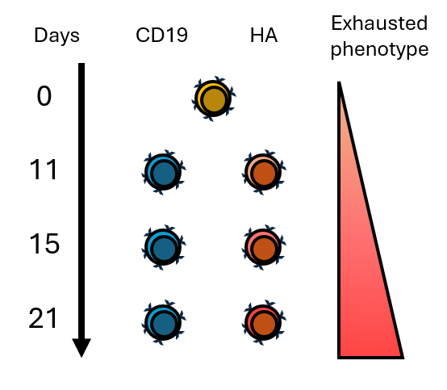
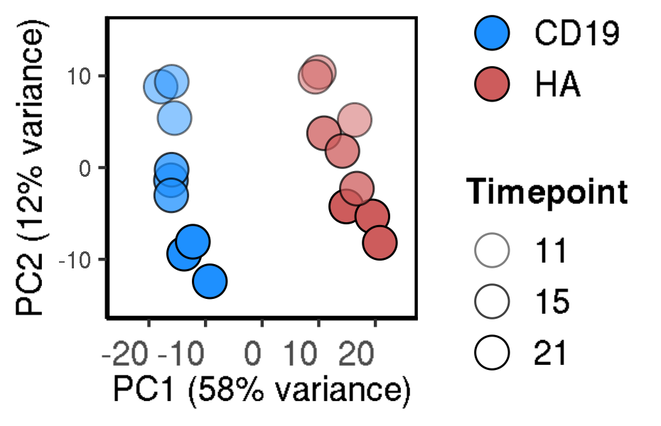
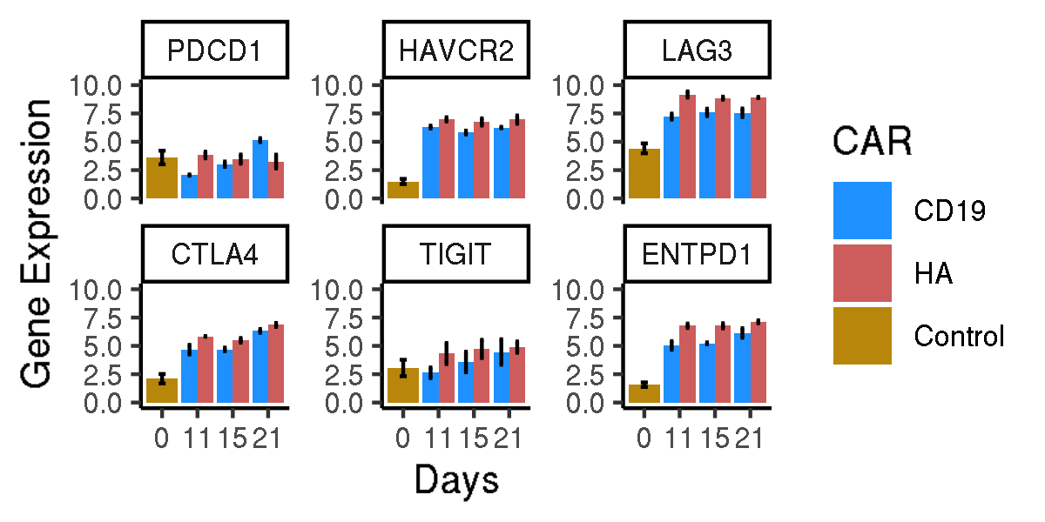
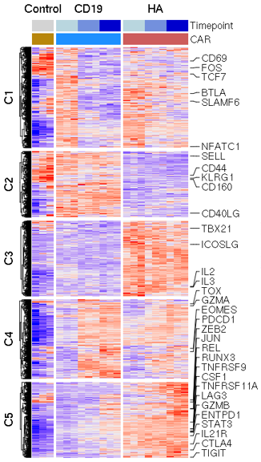
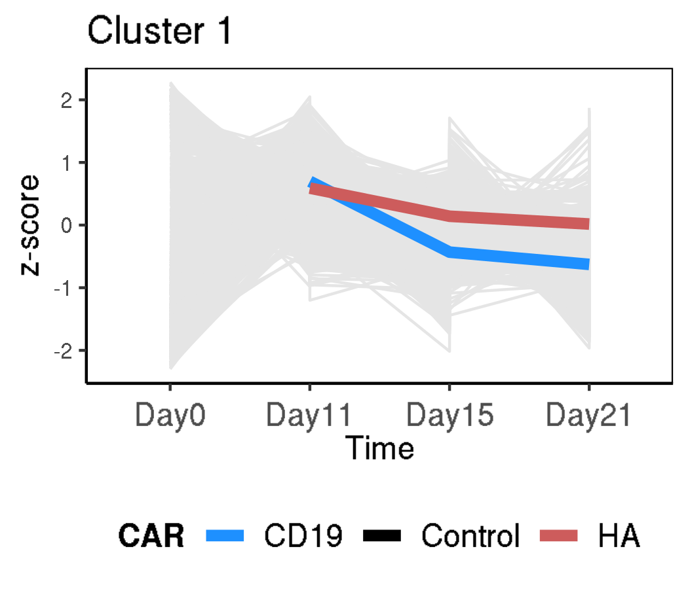
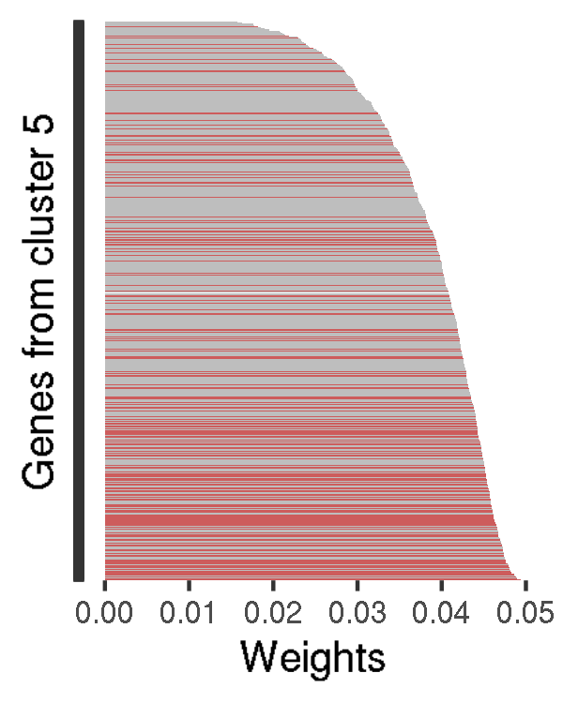
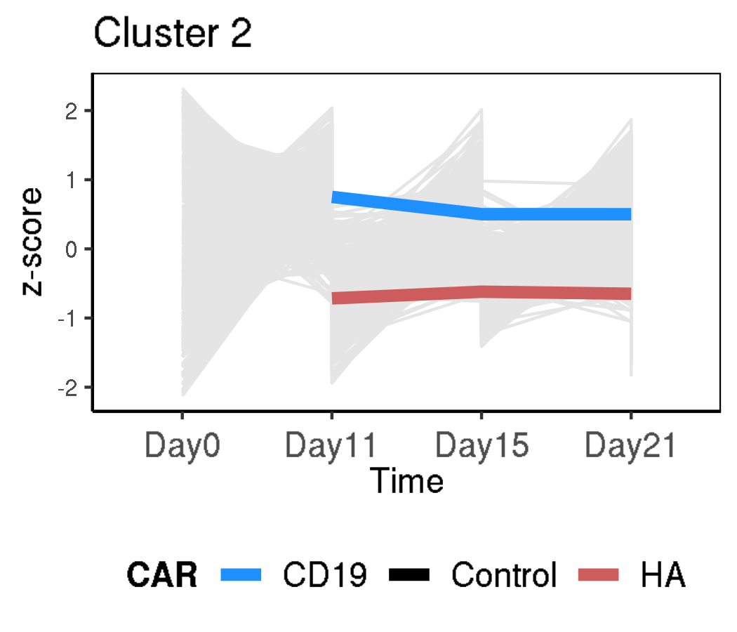
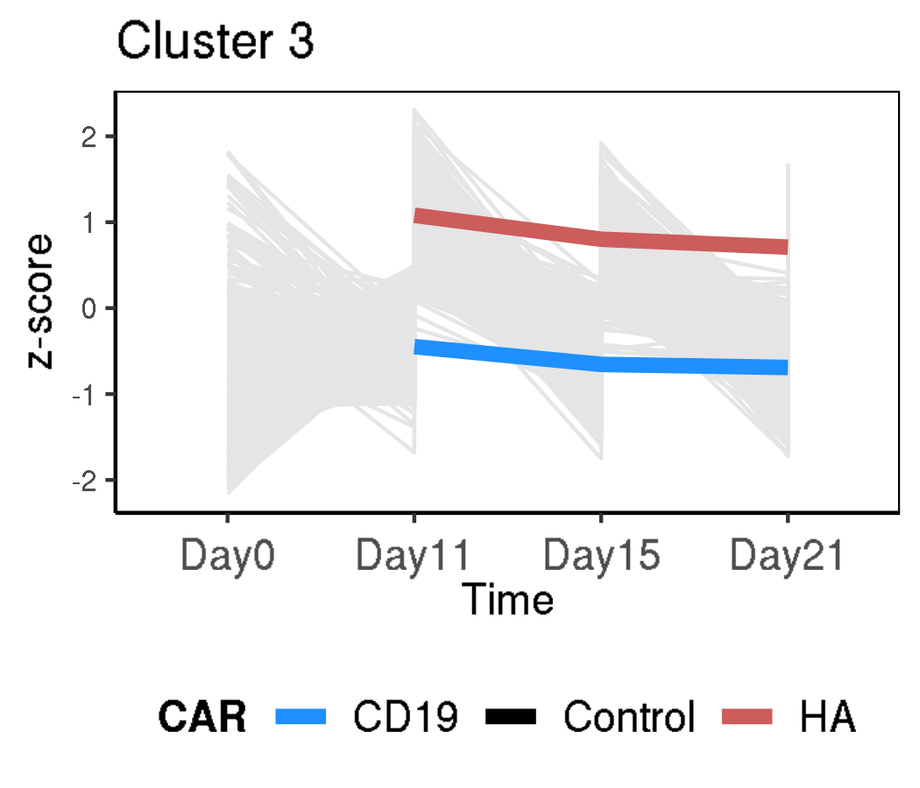
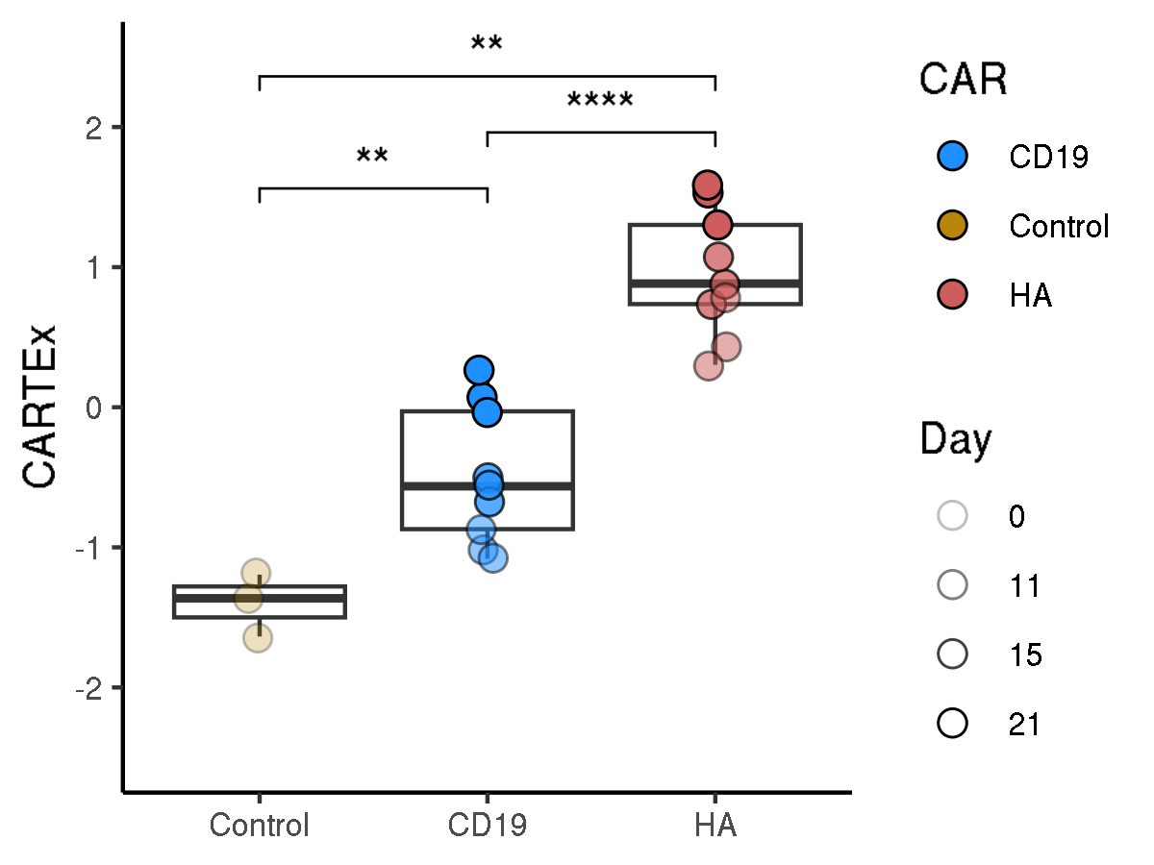
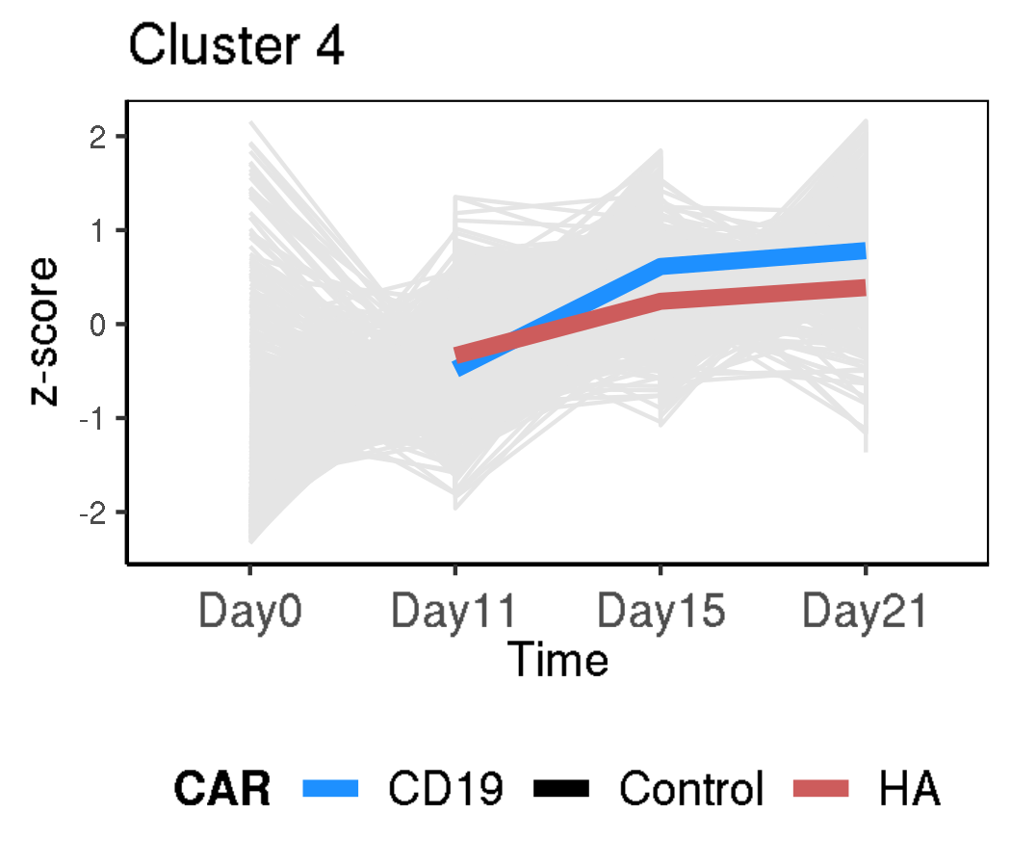
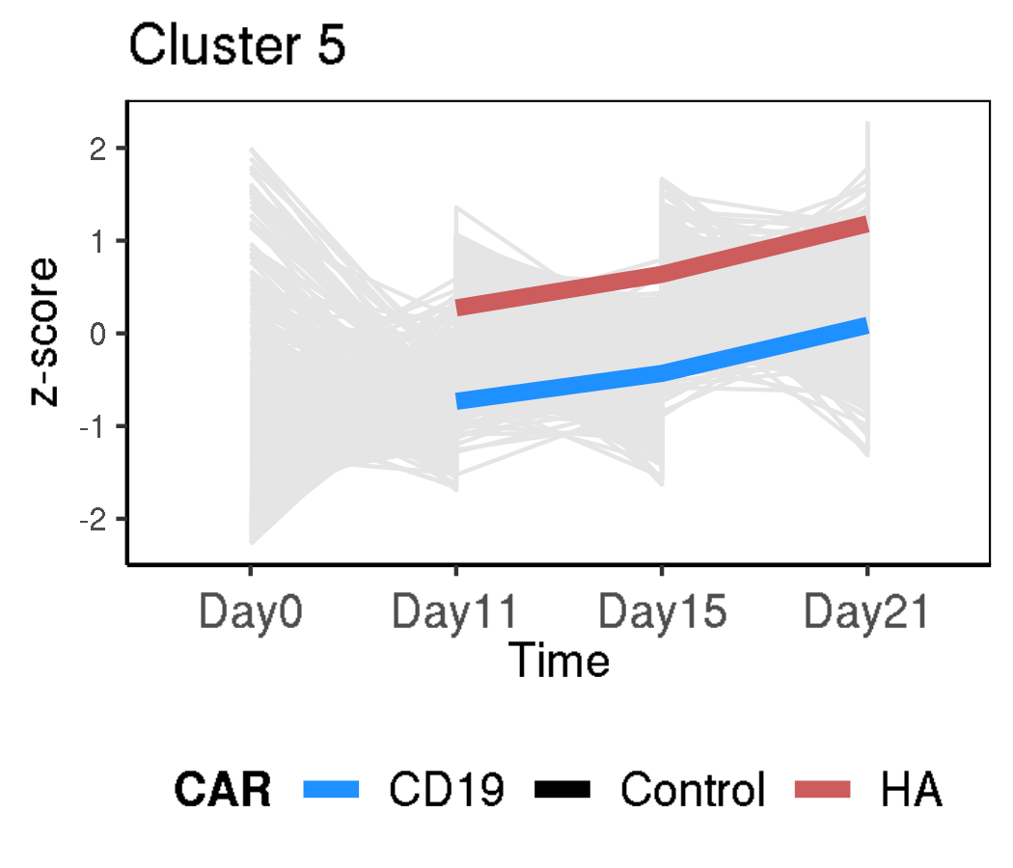
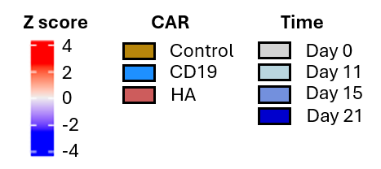
CARTEx project
Figure 1. Bulk RNA sequencing of functional and exhausted CAR T cells across 21 days
A
B
C
D
E
F
G

Slide 2
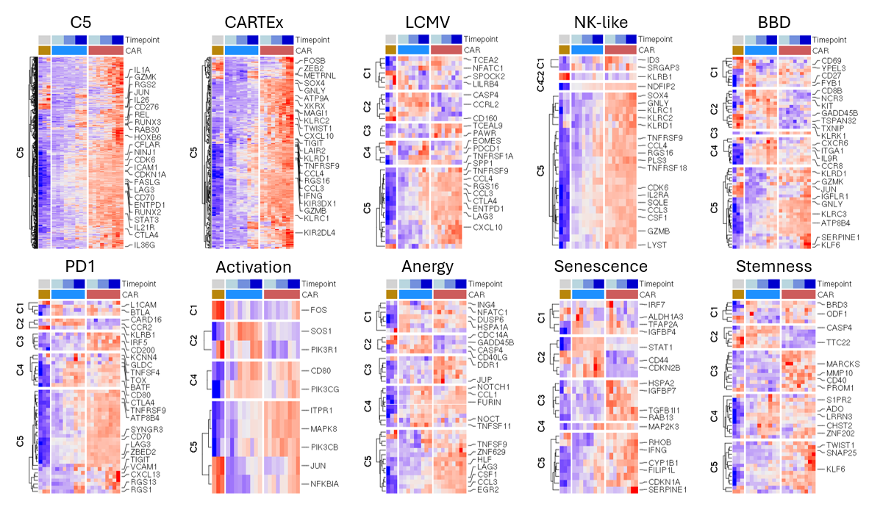
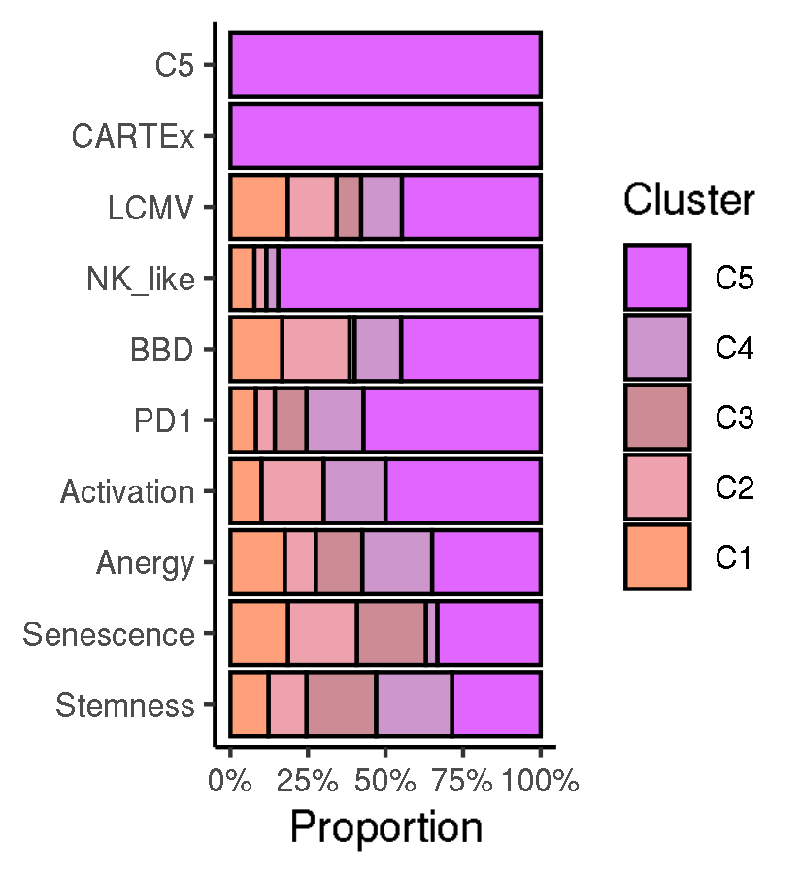
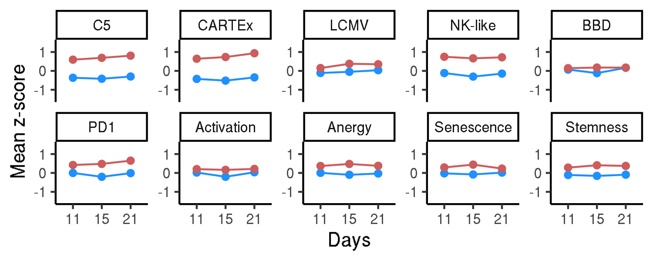
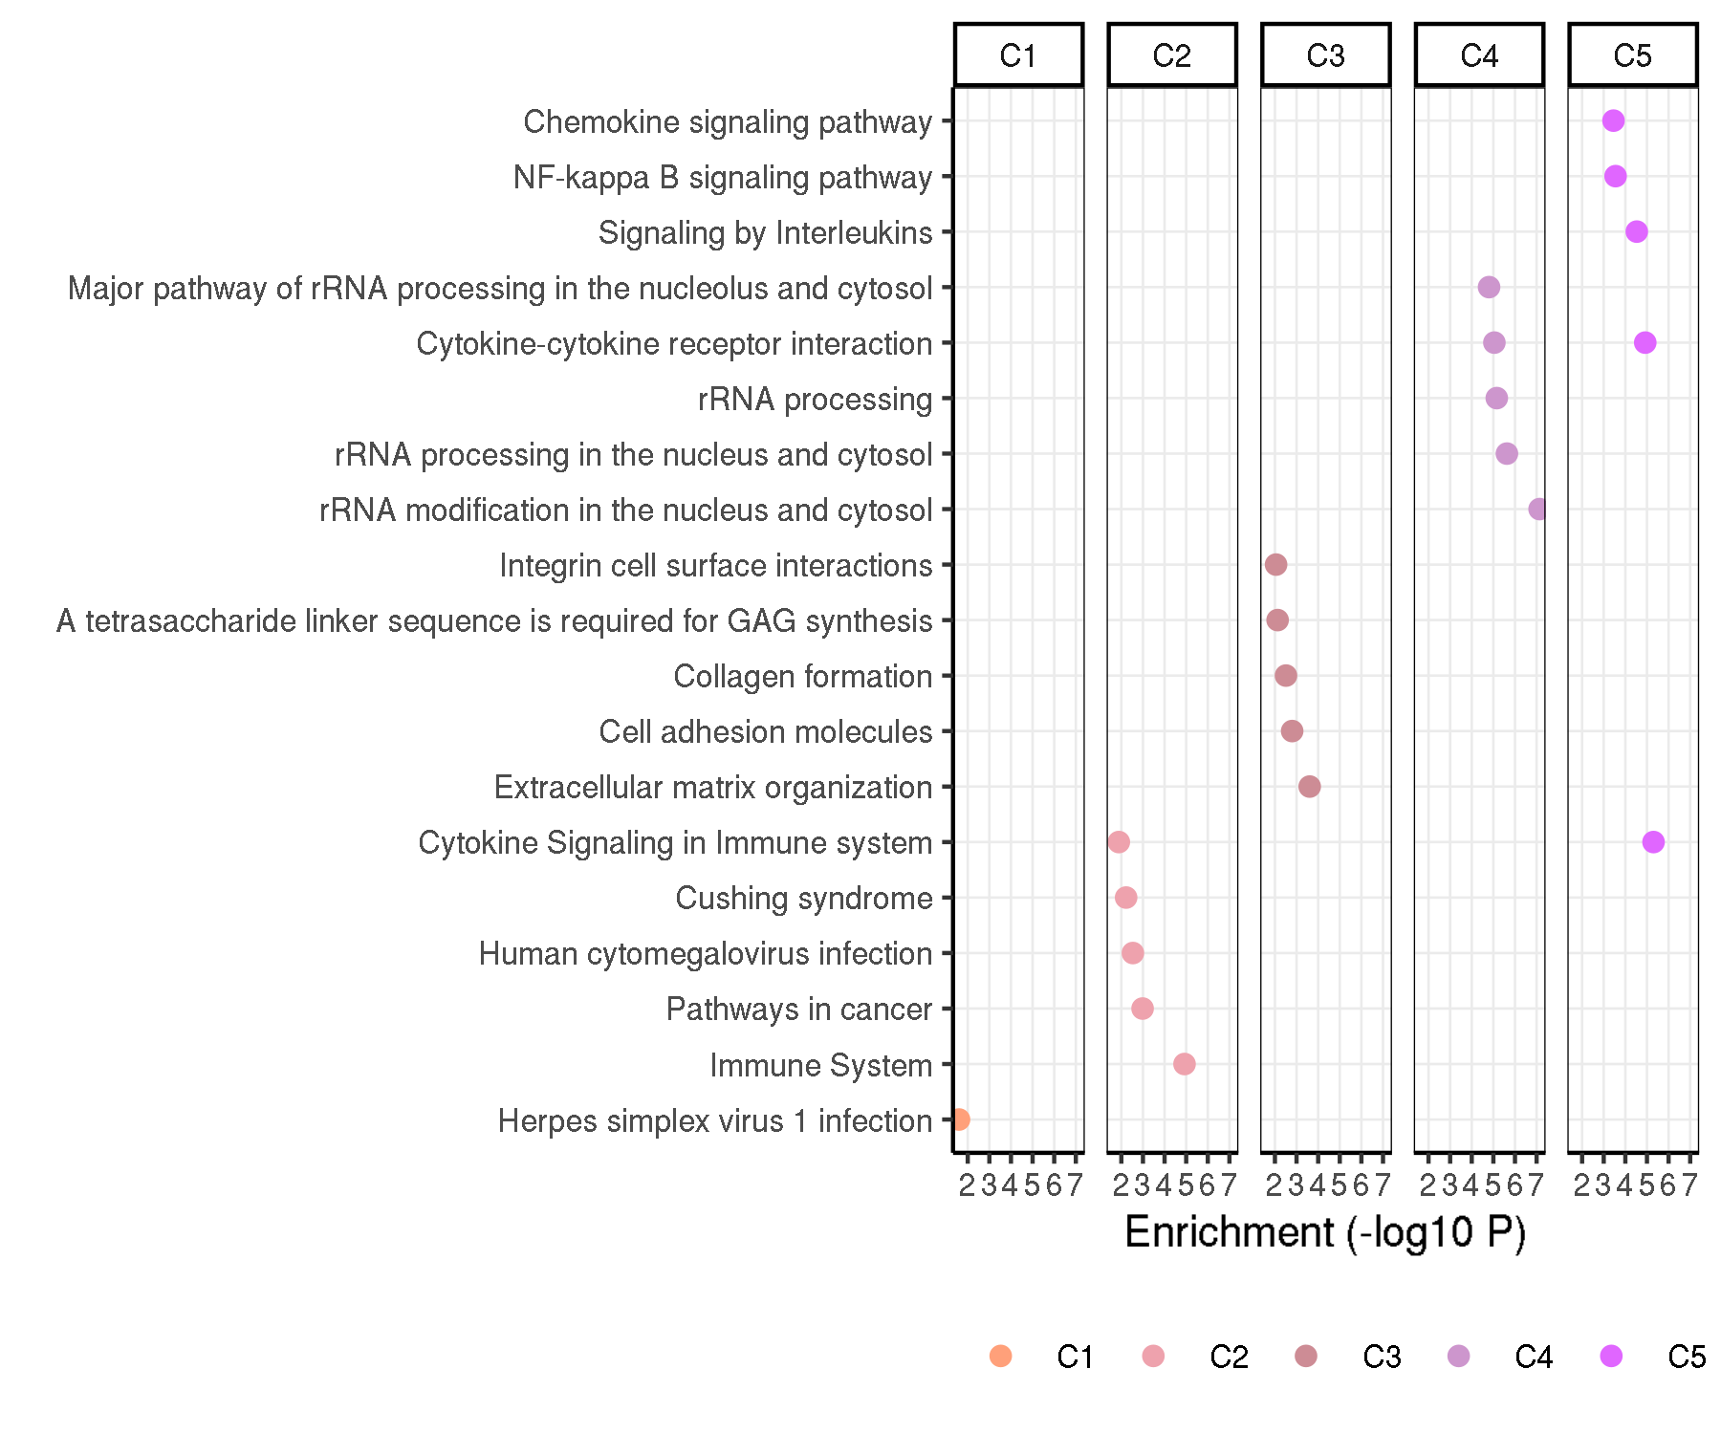
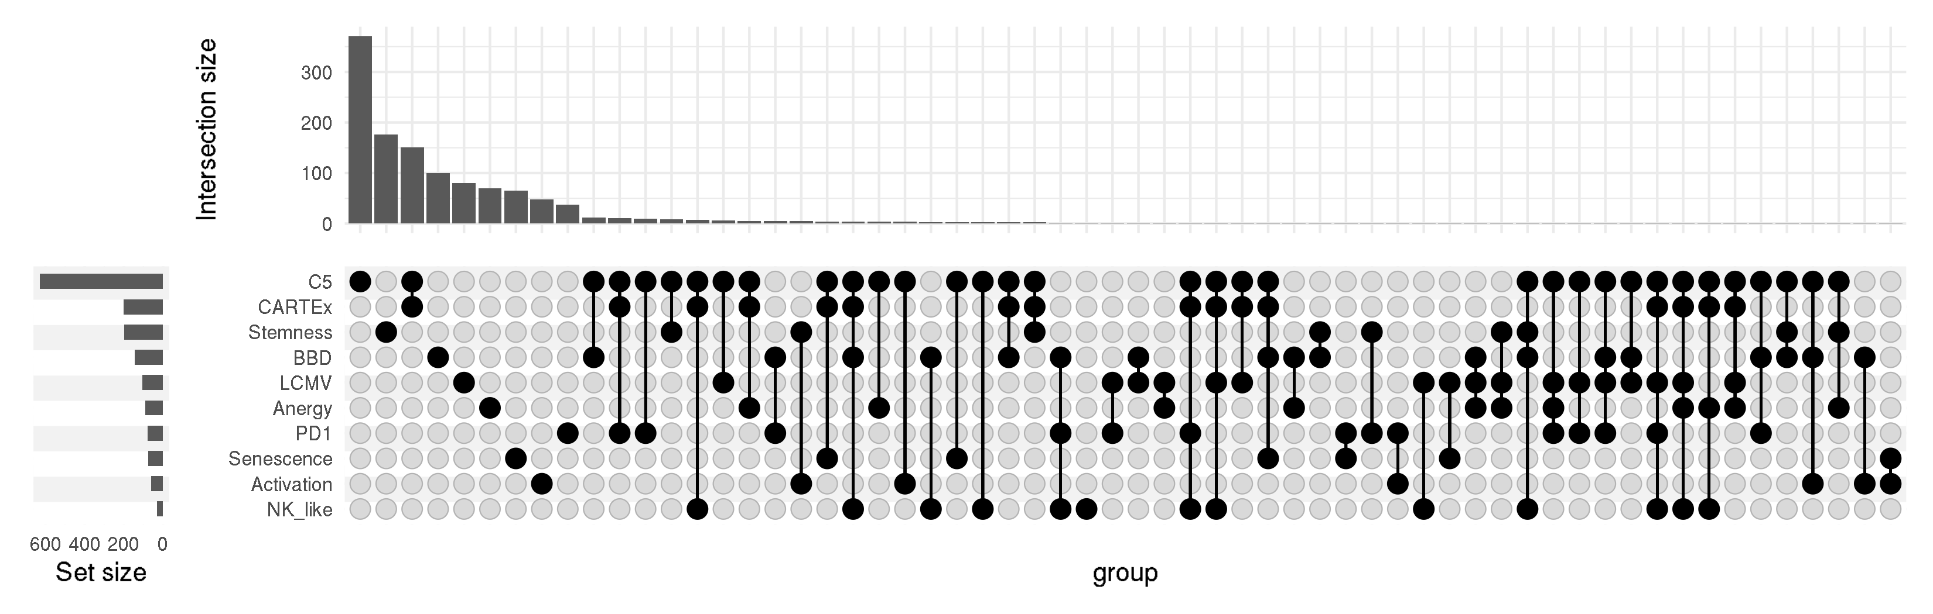
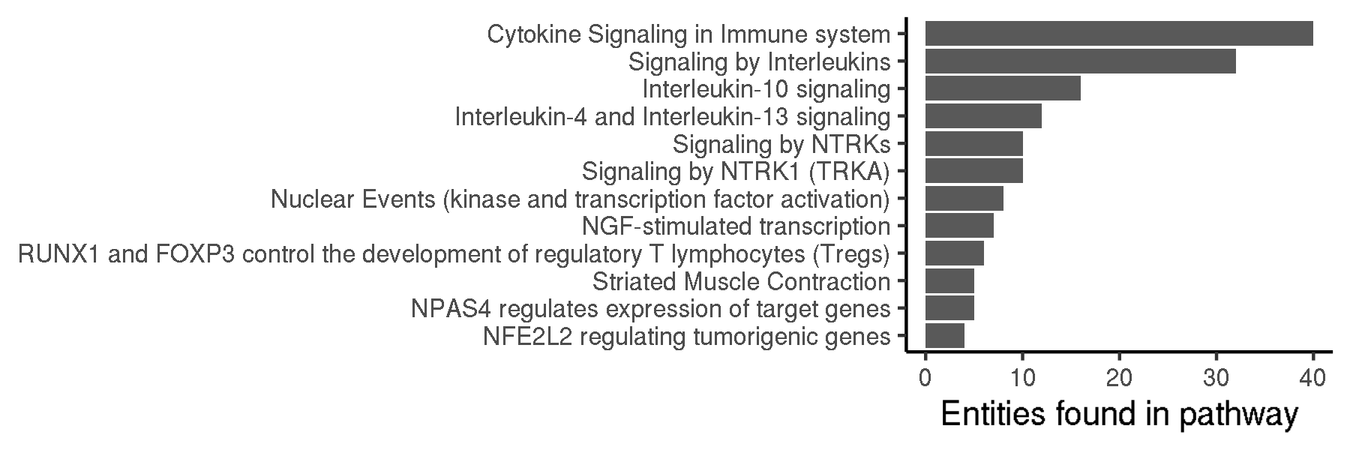
CARTEx project
Figure 2. Biological context / Evaluation with other exhaustion and cell state signatures
A
B
C
E
D
F

Slide 3
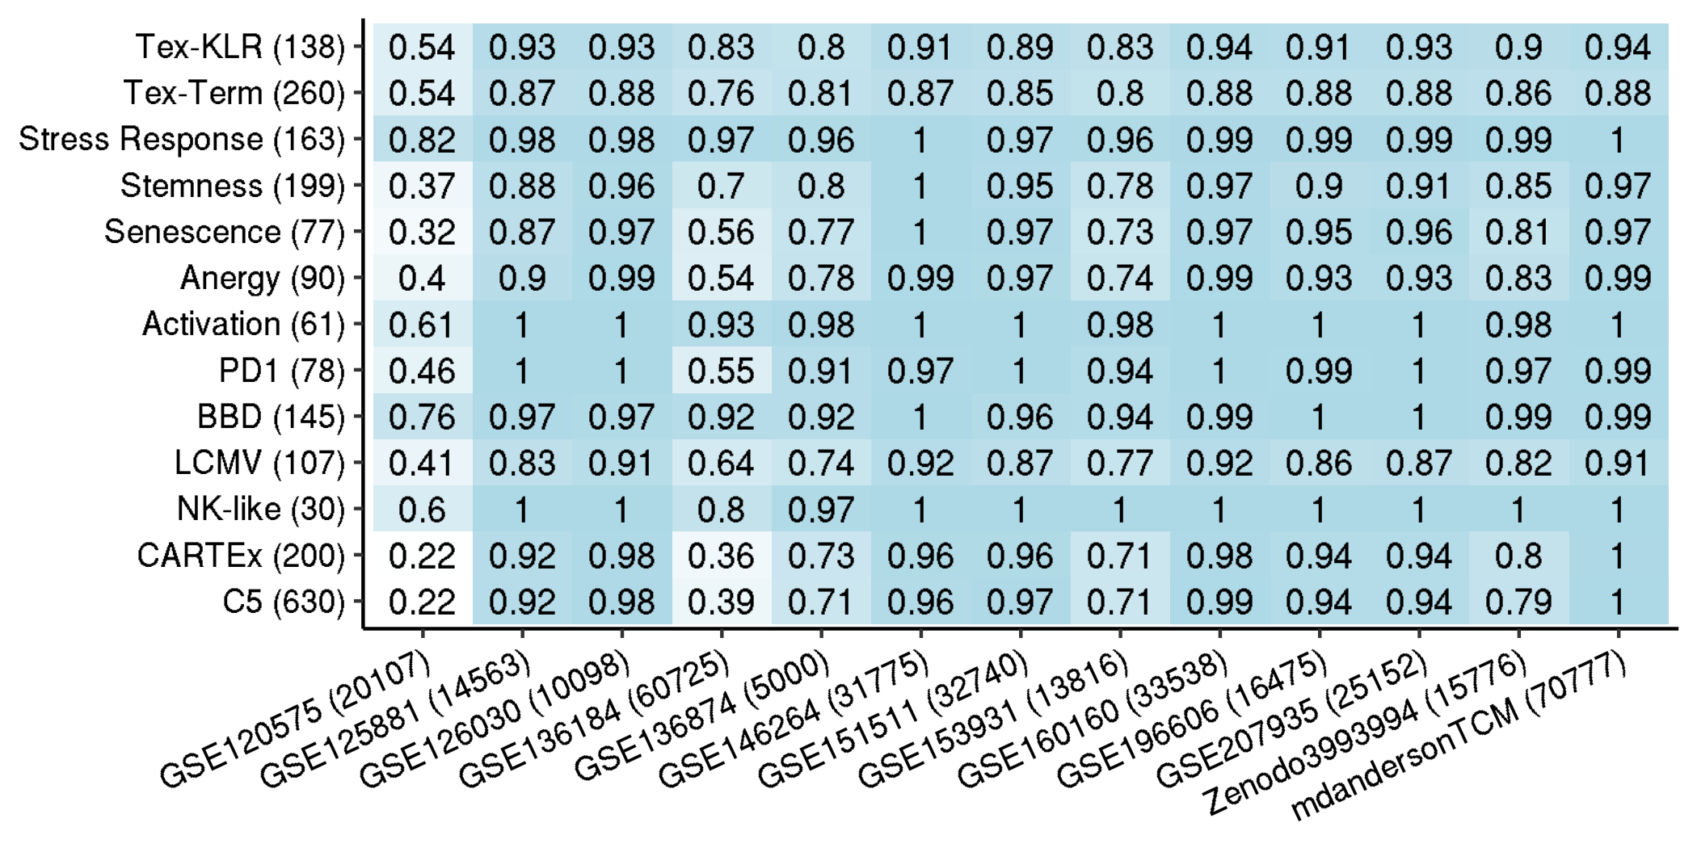
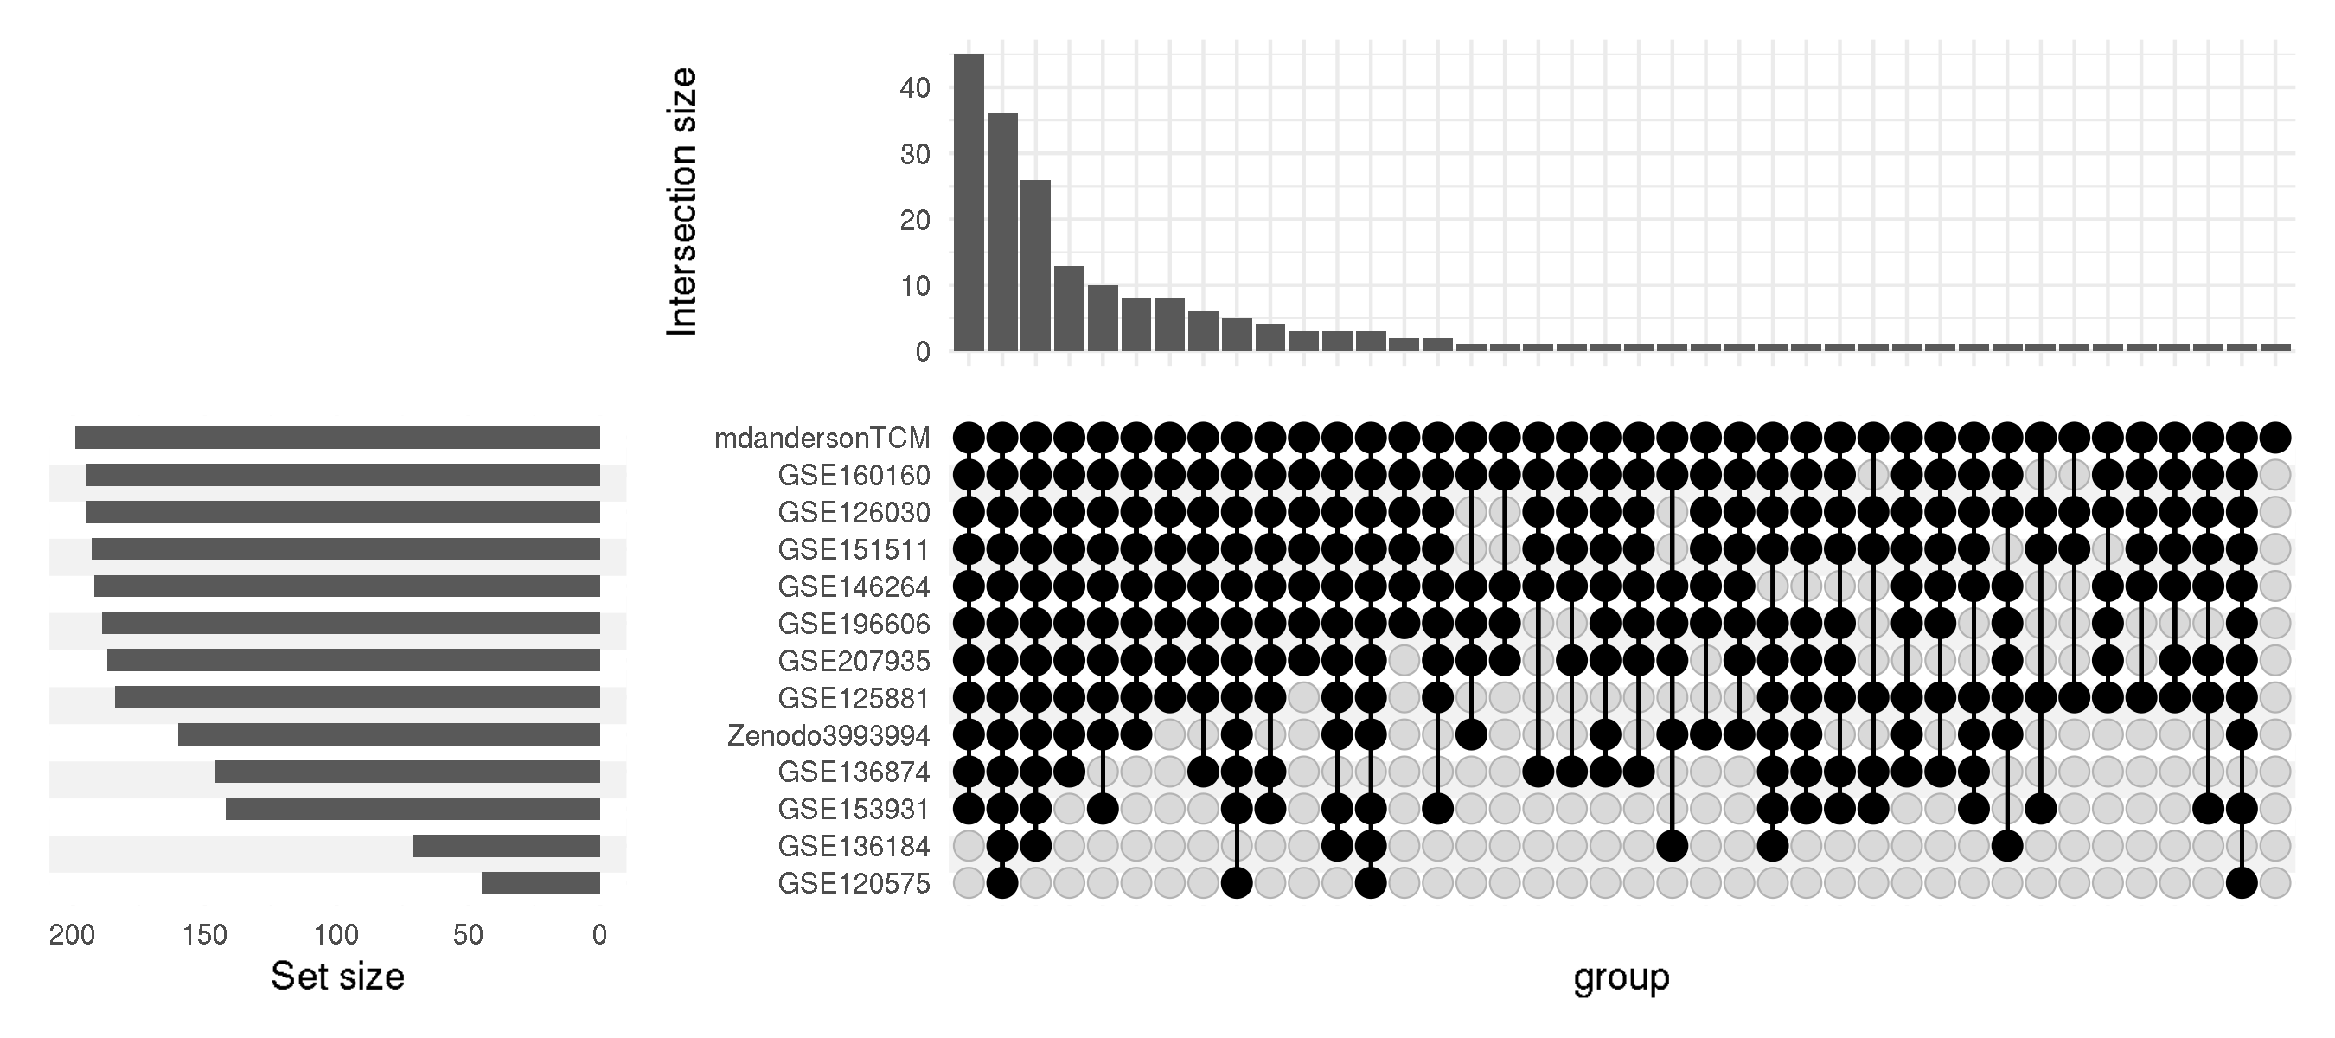
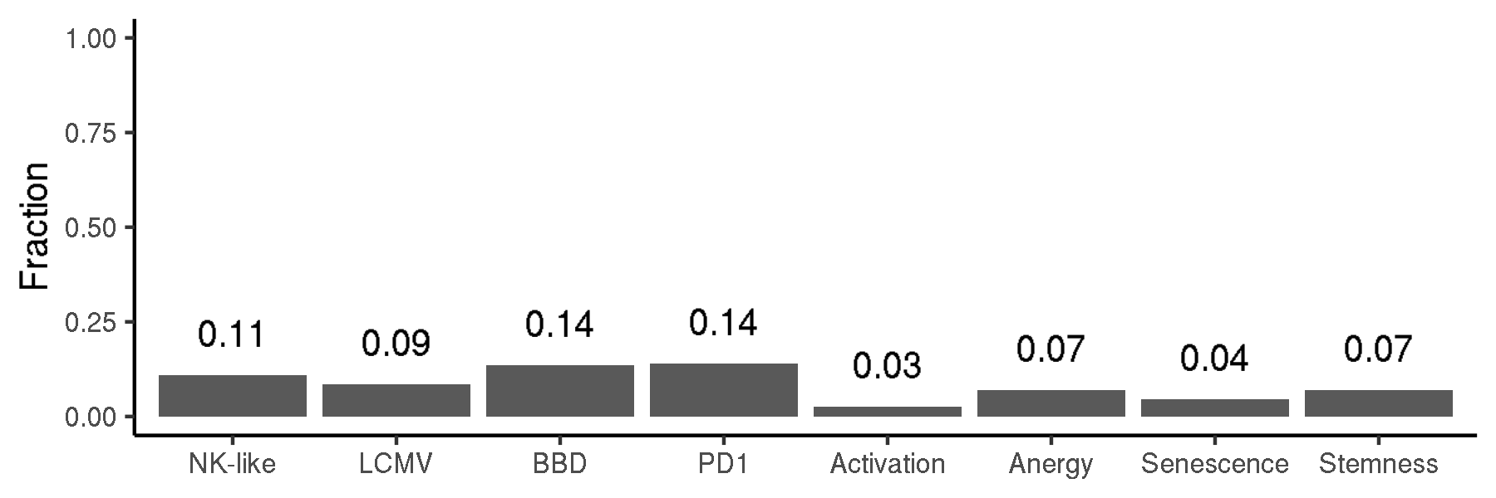
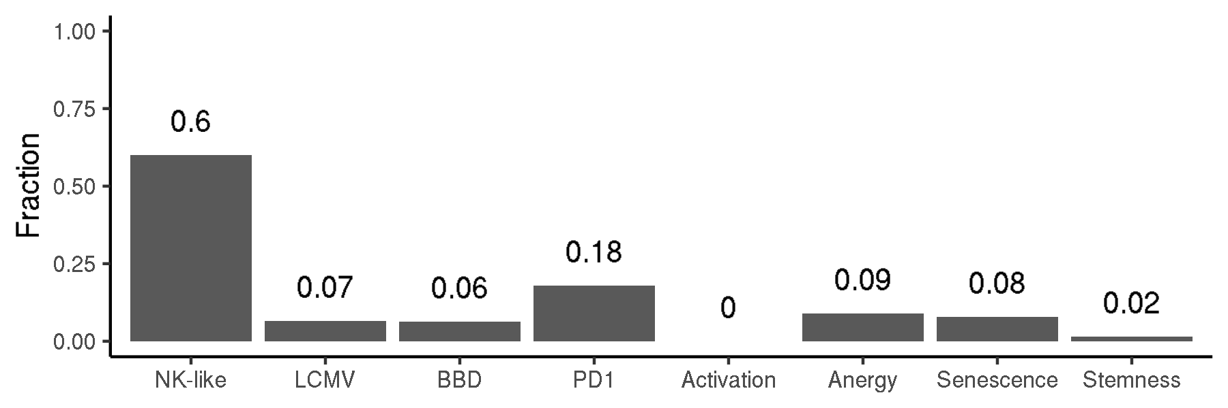
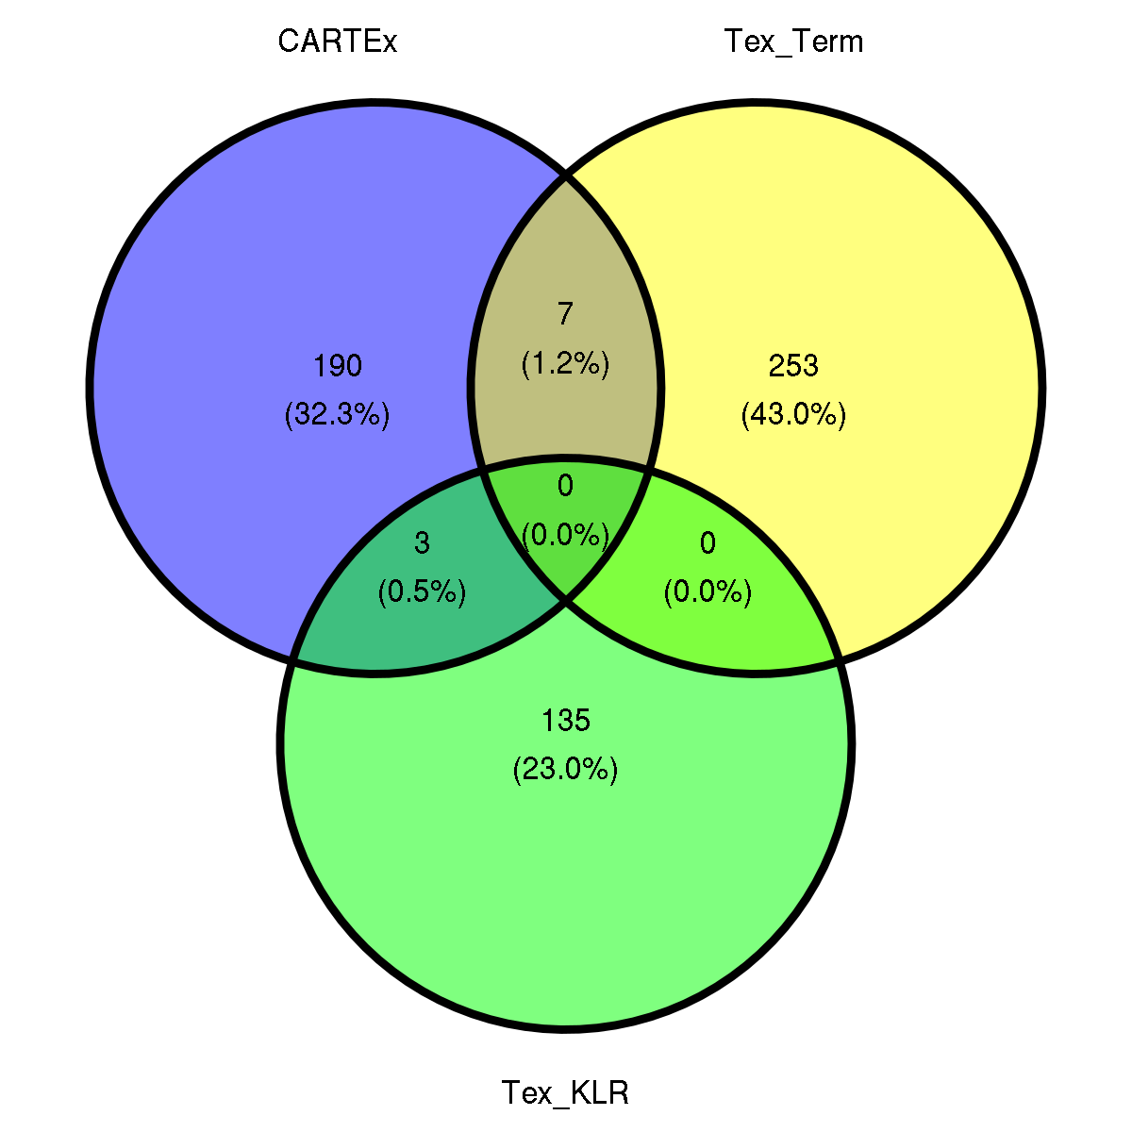
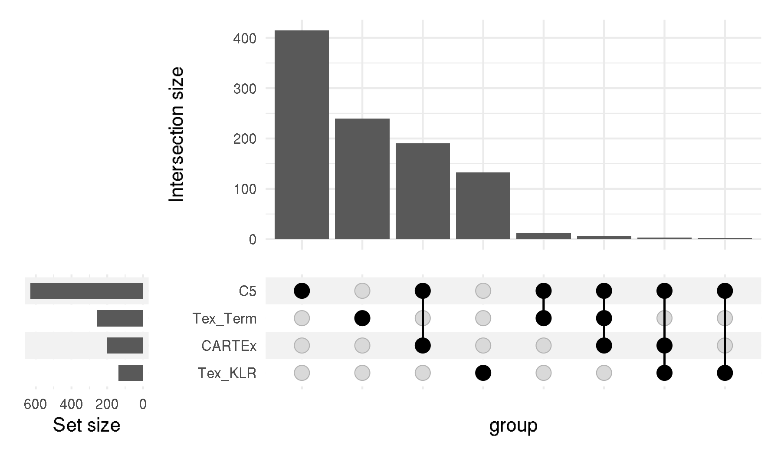
CARTEx project
Supplementary Figure 2. Signature representation
A
B
C
D

Slide 4
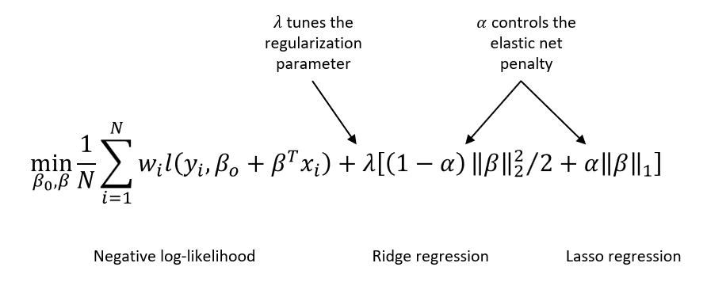
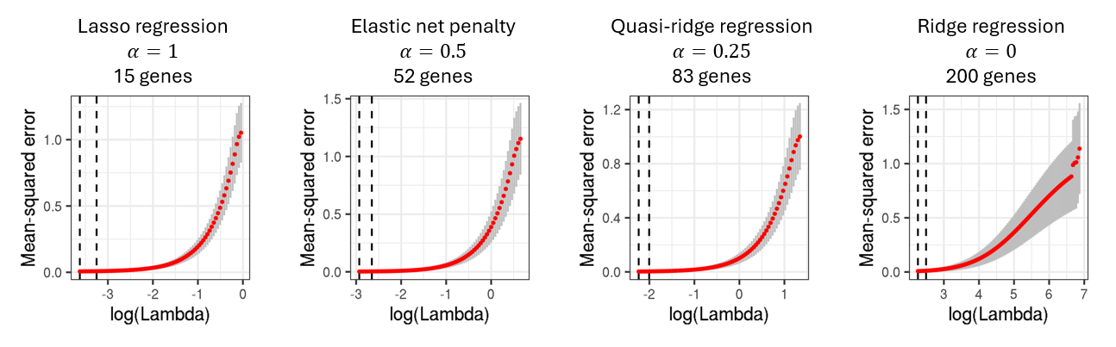
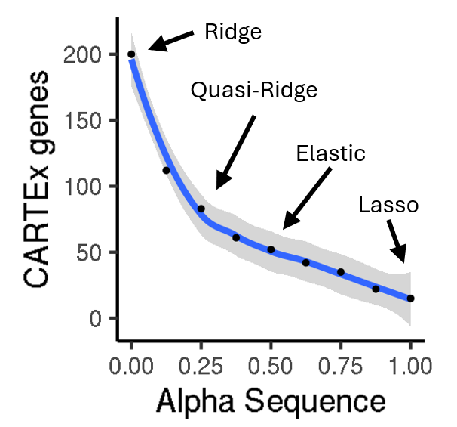
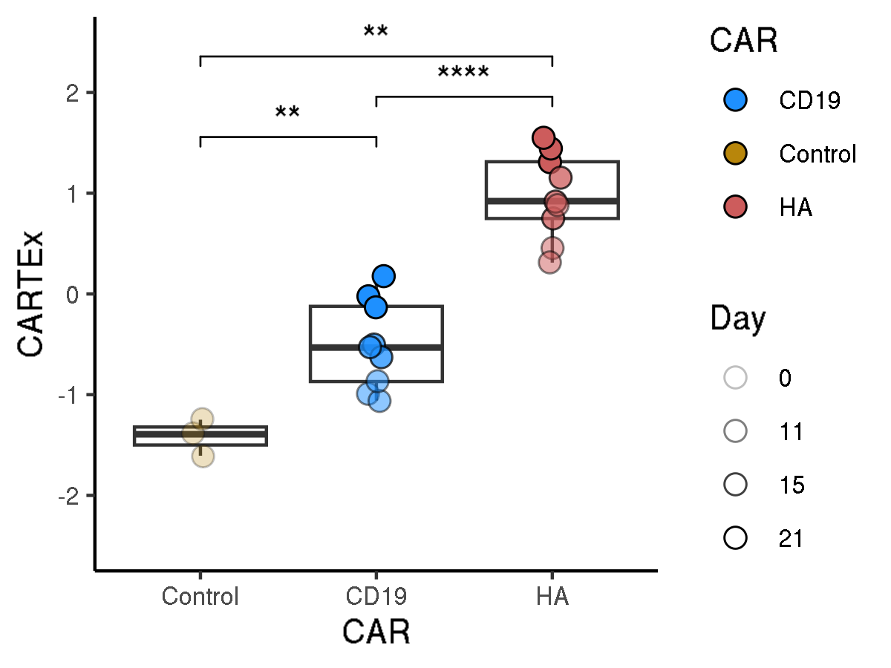
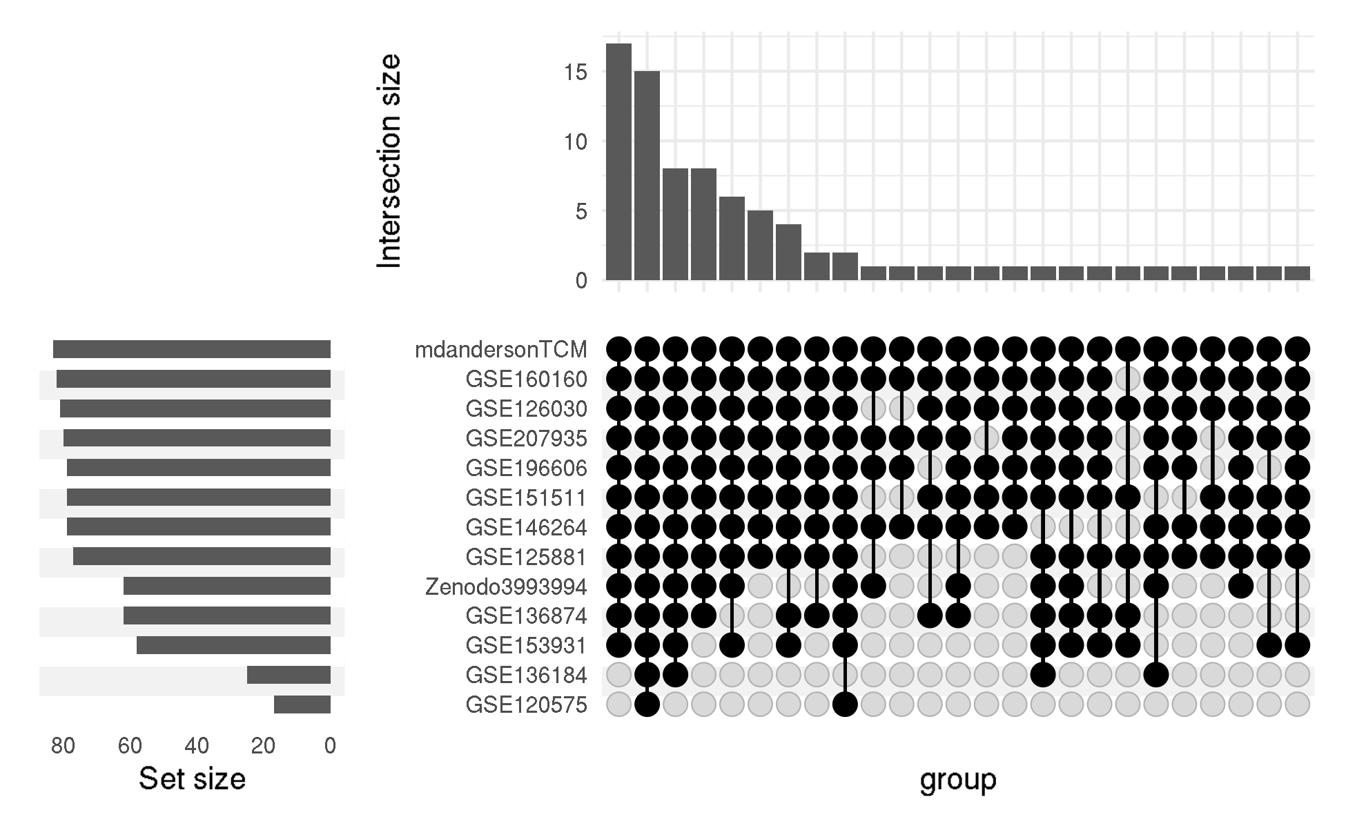
CARTEx project
Supplementary Figure 2. glmnet
A
B
C
D
E

Slide 5
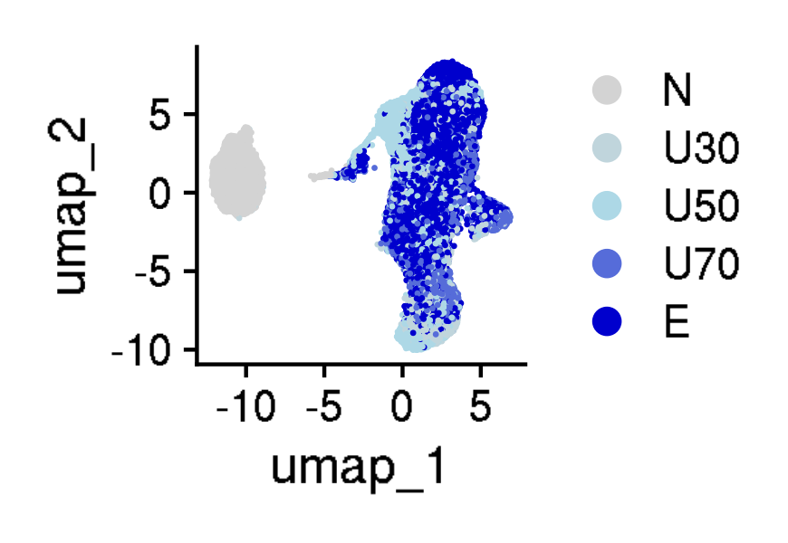
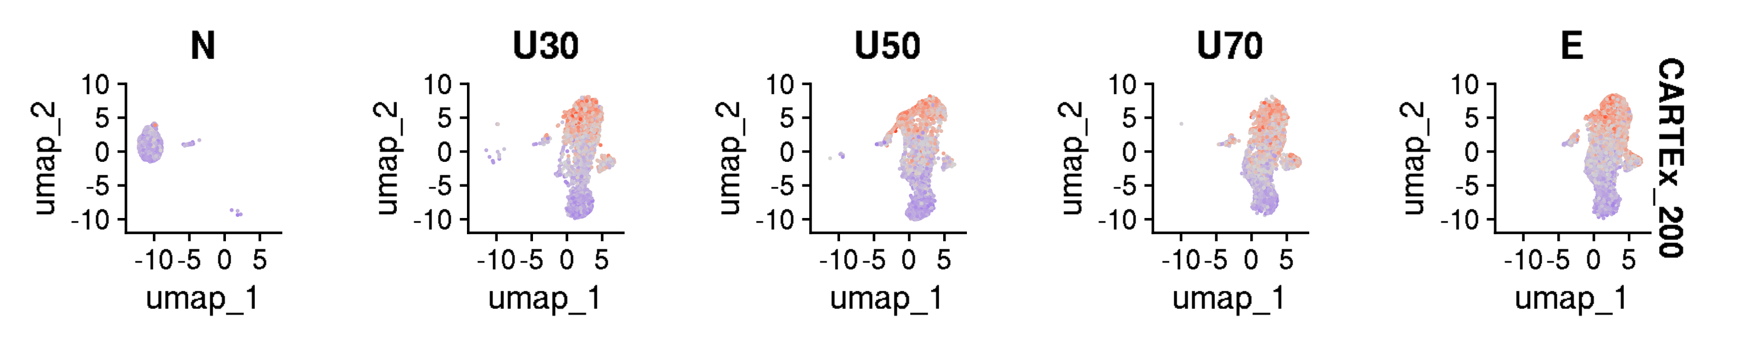
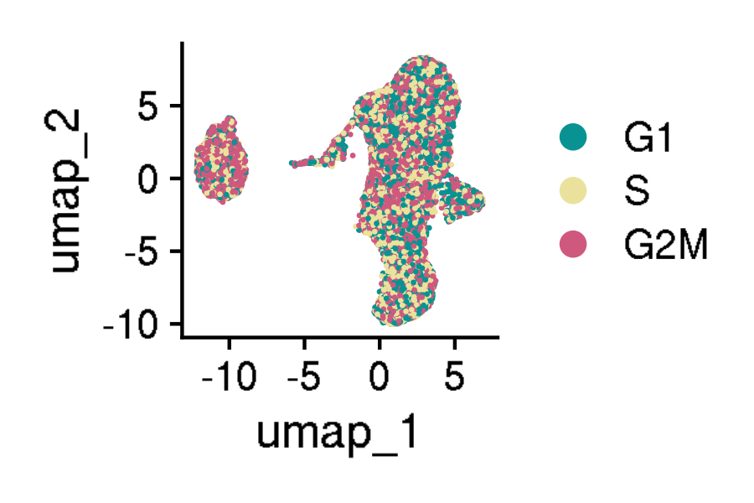
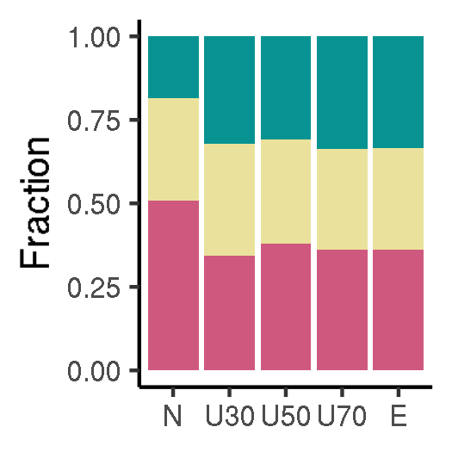
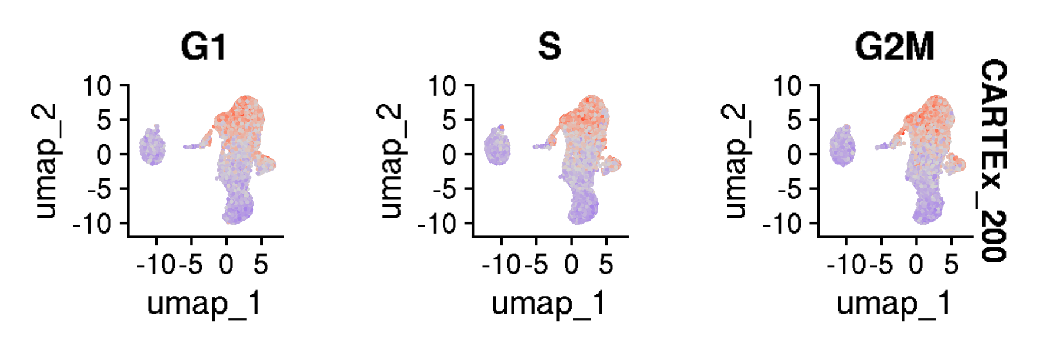
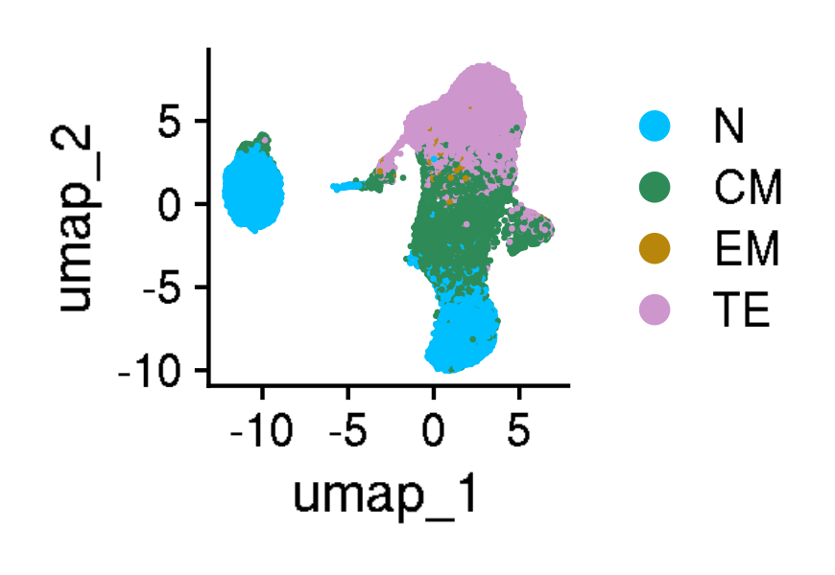
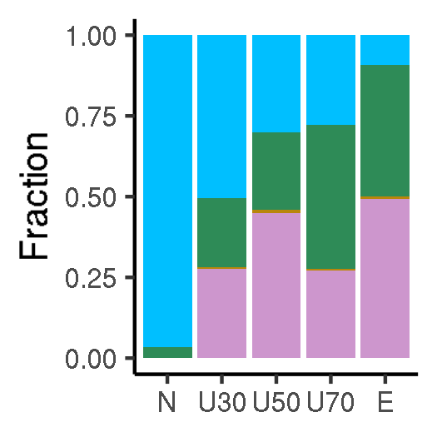
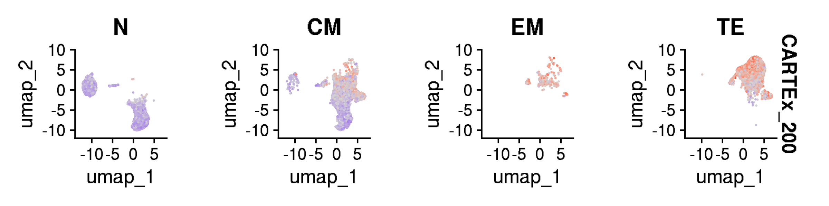
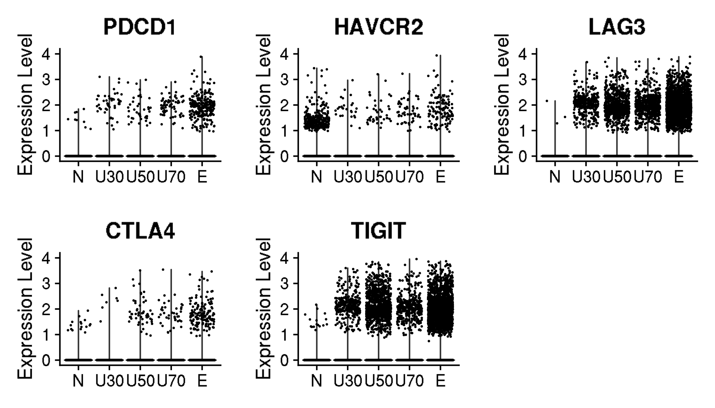
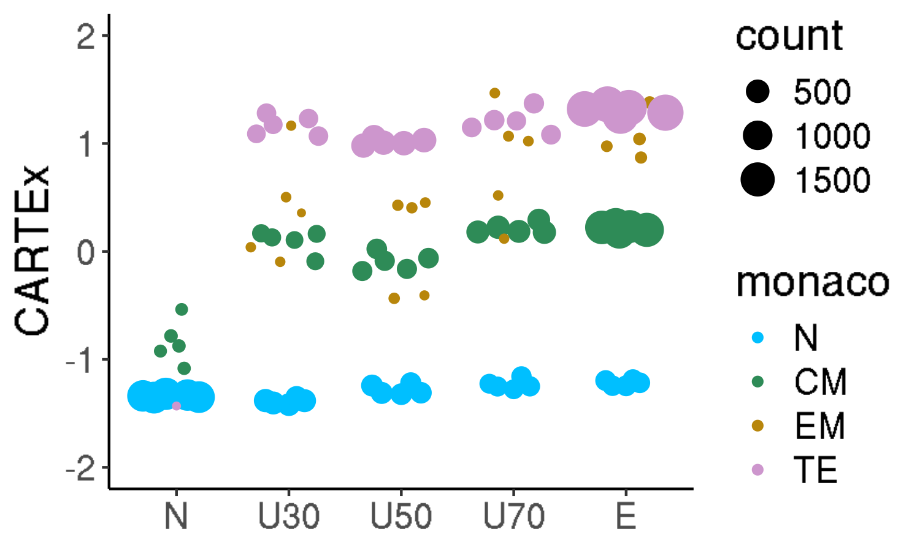
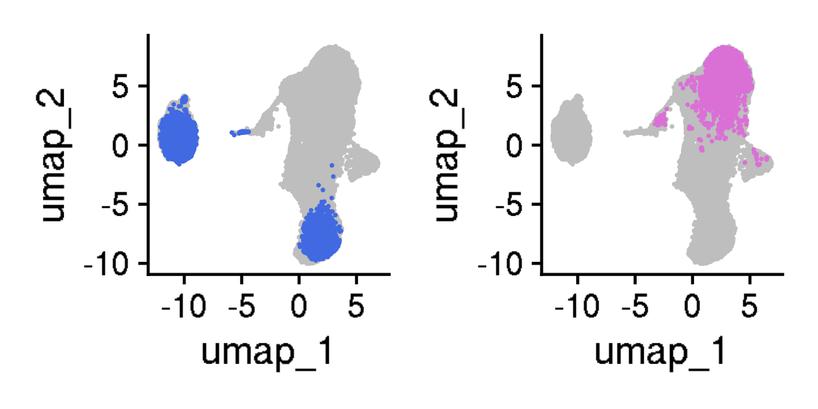
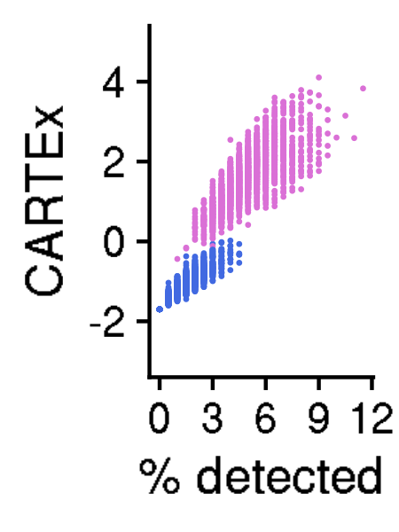
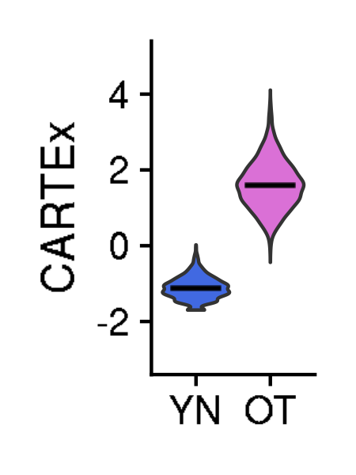
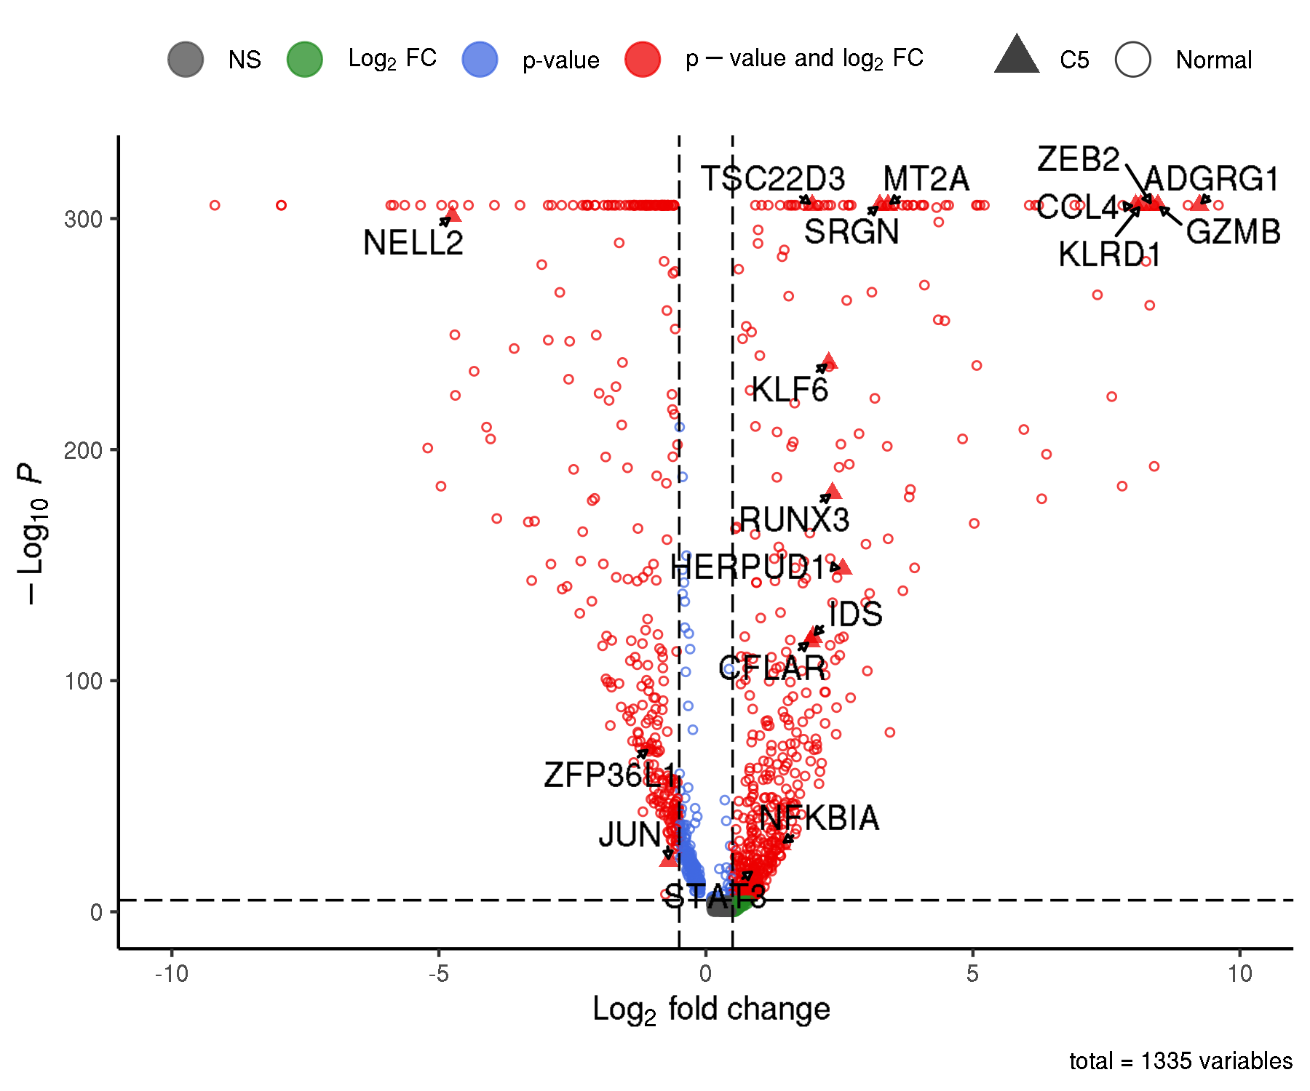
CARTEx project
Figure 4. T cell exhaustion is distinct from aging, cell cycle, and differentiation
A

Slide 6
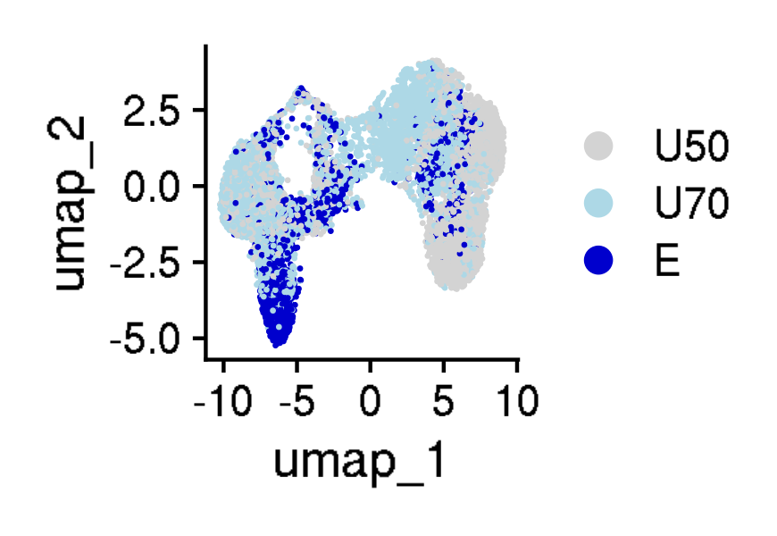
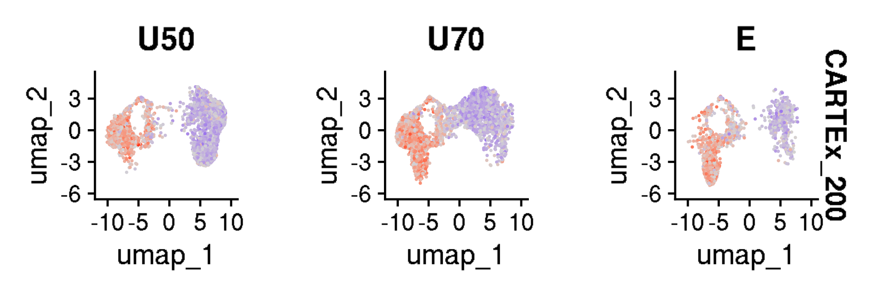
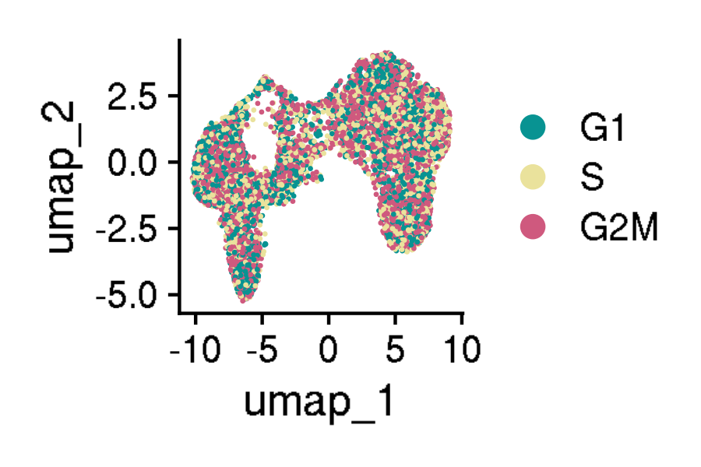
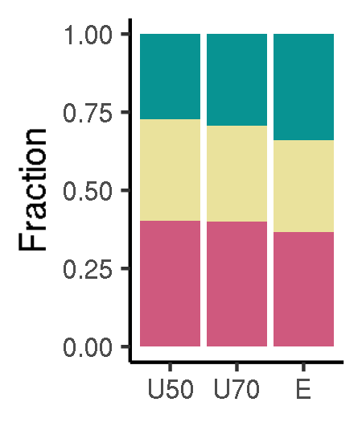
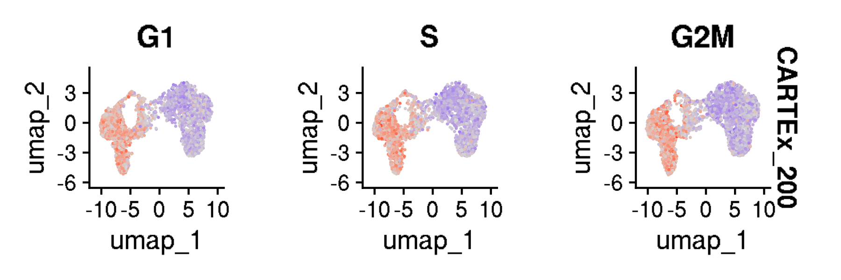
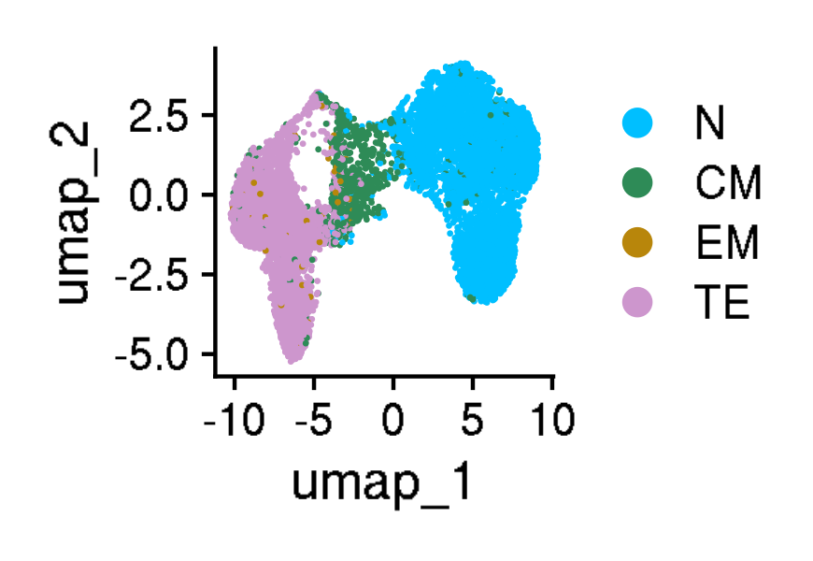
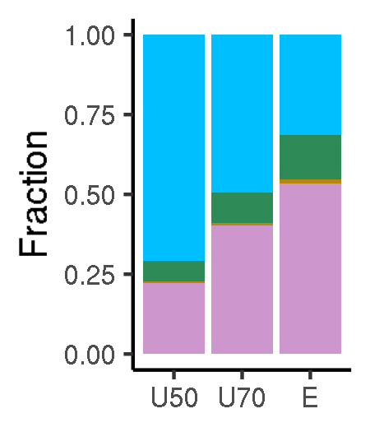

CARTEx project
Supplementary Figures for aging dataset

Slide 7





CARTEx project
Supplementary Figures for aging dataset

Slide 8




























CARTEx project
Figure 5. Validation in exhaustion-prone models

Slide 9






CARTEx project
Supplementary Figures for validation in exhaustion-prone models

Slide 10
























CARTEx project
Supplementary Figures for validation in exhaustion-prone models

Slide 11


CARTEx project
Supplementary Figures for validation in exhaustion-prone models

Slide 12














CARTEx project
Supplementary figures. Activation and resting T cells from healthy donors

Slide 13













CARTEx project
Supplementary figures. T cells from healthy donors and cancer patients (MD Anderson pan-cancer)

Slide 14





























CARTEx project
Figure 6. CARTEx applied to clinical oncology

Slide 15





CARTEx project
Supplementary Figure for CARTEx applied to clinical oncology

Slide 16
























CARTEx project
Supplementary Figure for CARTEx applied to clinical oncology

Slide 17













CARTEx project
Supplementary Figure. COVID-19 severity and SARS-CoV-2-reactive T cell exhaustion

Slide 18












CARTEx project
Supplementary Figure for CARTEx applied to clinical oncology

Slide 19












CARTEx project
Figure 7. CARTEx applied to CD8 T cells in autoimmune disorders

Slide 20













CARTEx project
Supplementary Figure. More STAT3 GOF

Slide 21







CARTEx project
Supplementary Figure. More STAT3 GOF (cell type differentiation)

Slide 22














CARTEx project
Supplementary Figure. More STAT3 GOF (diffusion maps)

Slide 23










CARTEx project
Supplementary Figure. Severe psoriasis is distinct from T cell exhaustion

Slide 24











CARTEx project
Supplementary Figure. BEACH domain deficiencies (autoimmunity caused by defective CTLA-4 trafficking)

Slide 25















CARTEx project
Supplementary Figure. T cell exhaustion in neurodegenerative diseases

